Slide 1




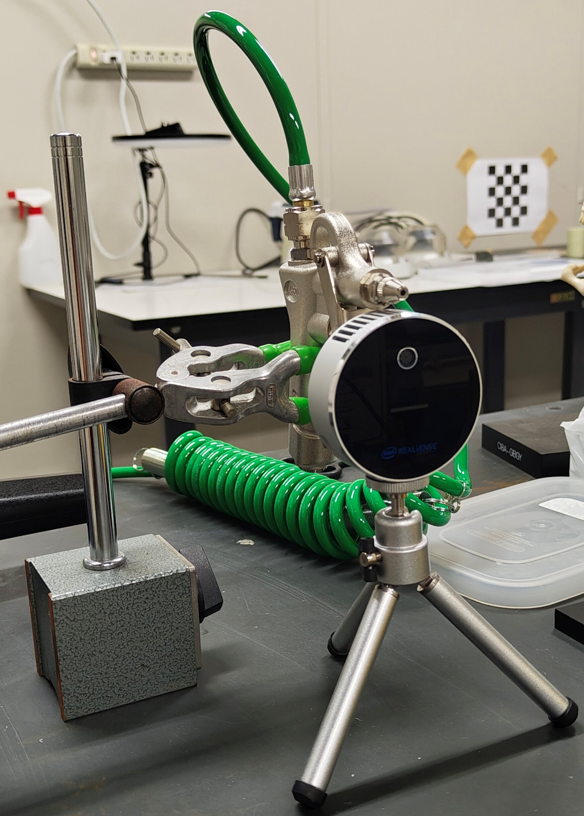
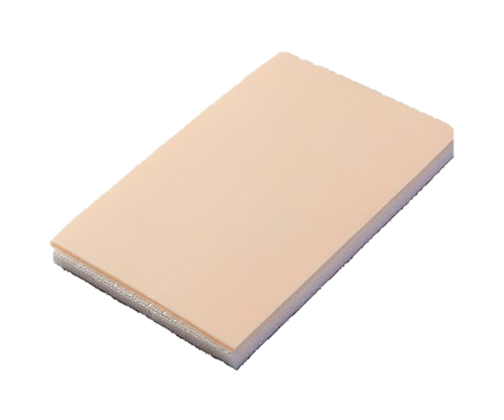
Non-Invasive Skin Phantom Properties Estimation Using Air-Jet Indentation And Active LiDAR Sensing
A Hygienic, Repeatable, and Real-Time System for Skin Biomechanics
PRESENTED BY
NAPAT NAOWARANGSEE 231512087
Master’s Degree Student, Frontier Engineering
1
Notes:
“Good afternoon, my name is Napat Naowarangsee, a master's student in Frontier Engineering.
Today I’m excited to present my work on a novel,

Slide 2

LITERATURE REVIEW
Notes:
"First of all, I would like to talk about literature review

Slide 3
LITERATURE REVIEW
Problem Statement
Notes:
let’s first explore the Problem statement that drive this work

Slide 4
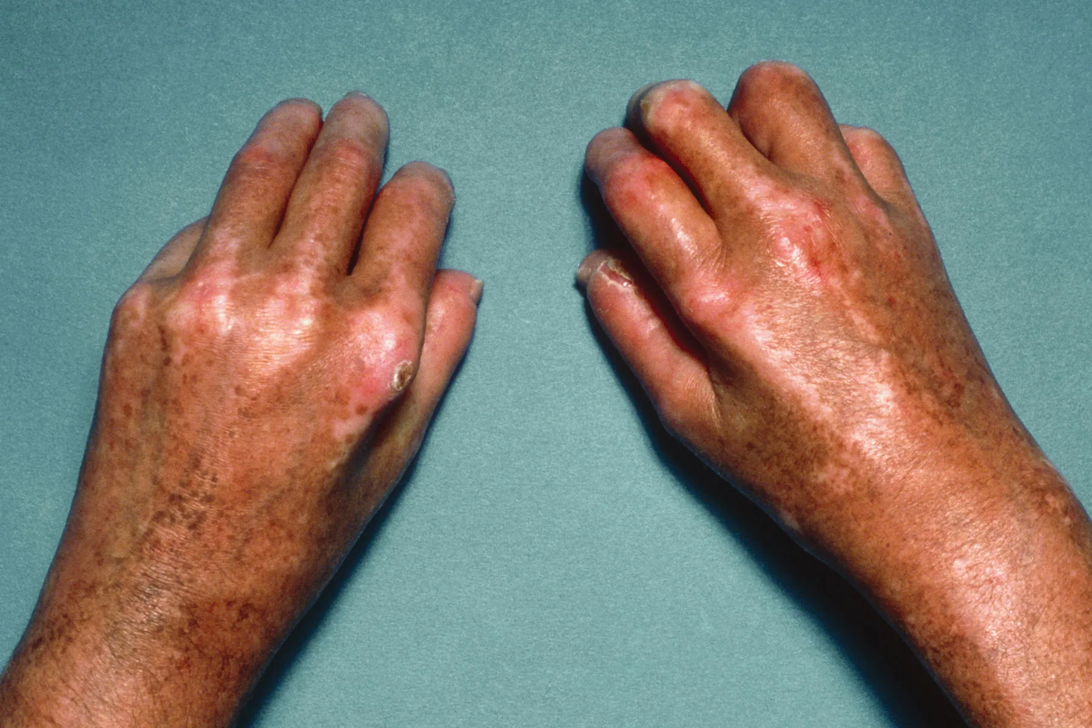
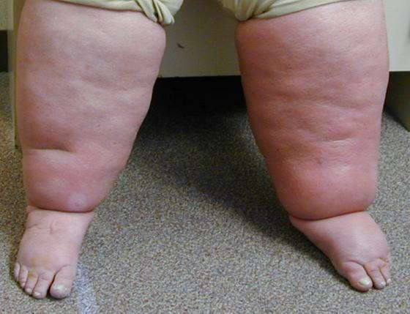
LITERATURE REVIEW
Problem Statement
Why Measure Skin Mechanics—And Why Non-Contact Matters?
Clinical Relevance:
Skin properties are biomarkers for:
Scleroderma, lymphedema, aging
Wound healing, pressure ulcer risk
Challenges in Current Practice:
Most tools require direct contact
→ Patient discomfort
→ Friction + boundary artifacts
→ Risk of cross-contamination
Need:
A non-contact, reliable method to measure in vivo skin properties safely and accurately
Notes:
Why Measure Skin Mechanics—And Why Non-Contact Matters?
“Skin mechanics—such as stiffness and elasticity—are important for diagnosing clinical conditions like scleroderma, monitoring lymphedema, and assessing skin aging or wound healing.
However, most current tools require direct skin contact, which can cause patient discomfort, friction-related artifacts, and hygiene concerns in clinical use.
These drawbacks highlight the need for a safe, reliable, and non-contact alternative that can be used in real-time clinical and research settings.”

Slide 5
LITERATURE REVIEW
Problem Statement
Why Measure Skin Mechanics—And Why Non-Contact Matters?
Criteria | Contact Methods (Indenters, Suction Devices) | Non-Contact Method (Air-Jet + LiDAR)
Skin Contact | Required (probe or suction chamber) | Not required (air-jet force + depth sensing)
Patient Comfort | Low – may cause discomfort or skin irritation | High – no physical contact
Hygiene & Sterilization | Requires disinfection or disposables | Excellent – no contamination risk
Operator Dependency | High – manual positioning introduces variability | Low – system is automated and repeatable
Cost & Complexity | Moderate to high | Moderate – consumer-grade LiDAR, simple jet
Suitability for Clinics | Limited – workflow bottlenecks, hygiene issues | High – fast, clean, and comfortable
Notes:
This brings us to a crucial comparison: how do conventional, contact-based methods stack up against a non-contact approach?
“This table clearly outlines the differences. Traditional methods like indenters or suction devices require direct contact, which introduces several problems: discomfort, sterilization requirements, and operator dependency.
On the other hand, a non-contact method—like air-jet and LiDAR systems—offers precise, automated measurements with no physical contact. It’s cleaner, more consistent, and better suited for real-time clinical use.”

Slide 6
LITERATURE REVIEW
Problem with
Conventional Techniques
Notes:
Let’s take a closer look at those conventional techniques’ technical drawbacks

Slide 7
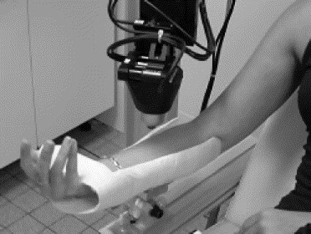
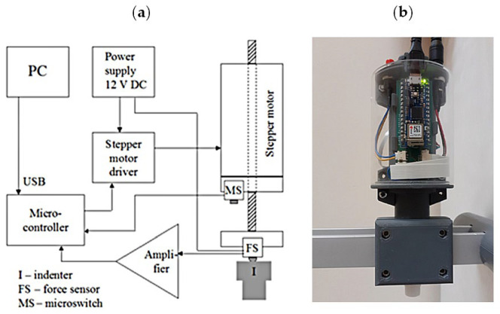
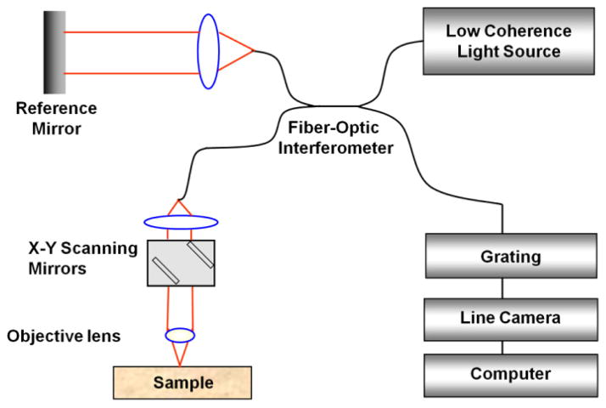
Problem with
Conventional Techniques
LITERATURE REVIEW
Limitations of Contact-Based and Optical Techniques
Contact-based tools introduce:
Friction artifacts
Operator dependence
Sterilization/cross-contamination concerns
Optical Coherence Elastography (OCE):
High resolution but shallow depth (<2 mm)
Expensive, complex setup
Limited portability
Notes:
“Contact-based systems often suffer from friction artifacts and operator-induced variability, which can distort results—especially in soft or mobile skin areas.
Meanwhile, optical techniques like Optical Coherence Elastography offer impressive resolution, but they only penetrate shallow layers—less than 2 mm. They also require complex alignment and are quite expensive for widespread use.
“That’s why I developed a system that avoids these problems entirely—delivering force without touch.
Let me show you how it works.”

Slide 8
LITERATURE REVIEW
Overview of Skin
Phantom Properties
Notes:
Let’s take a closer look at

Slide 9
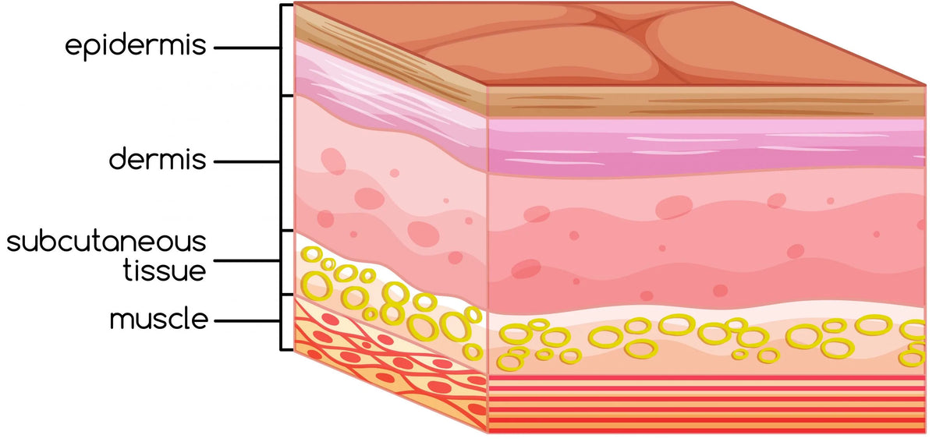
LITERATURE REVIEW
Overview of Skin
Phantom Properties
Layers of Human Skin
Skin thickness
≈ 0.1 mm → epidermis
≈ 1 – 4 mm → dermis
4 - 10 → mm hypodermis (deep skin/fat layer)
>27 mm → reaches underlying muscle
(1)
(1)
(1)
(2)
(1) https://www.utmb.edu/pedi_ed/CoreV2/Dermatology/page_03.htm?
(2) https://doi.org/10.1038/s41598-023-44572-y
Notes:
“Human skin is multilayered—ranging from a thin epidermis to a thicker dermis and a deep skin layer where is a hypodermis layers belong.

Slide 10
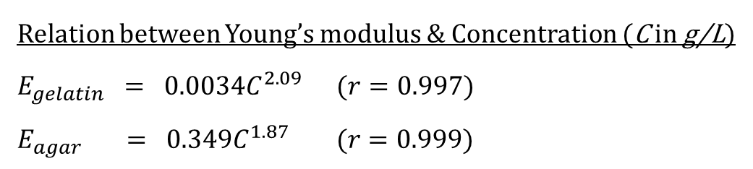
LITERATURE REVIEW
Overview of Skin
Phantom Properties
Skin Phantom
Material | Pros | Cons
Gelatin (30 – 180 g/L) | Inexpensive and widely available Easy to prepare by simple heating and cooling Tunable stiffness via concentration and bloom strength (4.8 – 158 kPa) | Prone to dehydration and syneresis; requires refrigeration and sealed storage Limited lifespan (≈1 week) due to microbial growth Viscoelastic behavior can vary with temperature and additives
Agarose (5 – 30 g/L) | Heat‐stable hydrogel with predictable gelation Broad stiffness tuning (≈ 7.6 to 195 kPa) by concentration Good optical clarity for imaging applications | Requires precise heating (~95 °C) to dissolve Brittle at low concentrations, prone to cracking Limited lifespan (≈5 days) due to syneresis
Accessible chemical.
Cost-effective and easily tunable.
Limited lifespans and require careful storage.
Relation between Young’s modulus & Concentration (C in g/L)
$$E_{gelatin} = 0.0034C^{2.09 } (r=0.997)$$
$$E_{agar} = 0.349C^{1.87 } (r=0.999)$$
T. J. Hall, M. Bilgen, M. F. Insana, and T. A. Krouskop, "Phantom materials for elastography," IEEE Transactions on Ultrasonics, Ferroelectrics, and Frequency Control, vol. 44, no. 6, pp. 1355–1365, Nov. 1997, doi: 10.1109/58.656136.
Notes:
In testing, we often simulate these layers using hydrogels like gelatin and agarose, which allow us to tune mechanical properties by adjusting their concentration.”
Gelatin is inexpensive, easy to prepare, and tunable—but it dehydrates easily.
Agarose offers a broader stiffness range and better optical clarity, but it’s brittle at low concentrations and harder to dissolve.
Nevertheless, both materials exhibit tunable Young’s modulus values that closely match biological skin, which makes them ideal for system validation.”

Slide 11
LITERATURE REVIEW
Overview of Skin
Phantom Properties
Skin Phantom Condition
Requirement | Specification
Target Young’s modulus (E) | 5 kPa – 190 kPa
Thickness (L) | 20 mm – 30 mm (according to skin thickness)
Surface finish | Matte, diffuse (to optimize LiDAR returns)
Ease of fabrication | Minimal equipment, accessible chemicals
(1)
(2)
(1) Mayrovitz, H.N. (2017). Mechanical properties of ballistic gelatin and their relation to tissue-like behavior. J. Biomech. Eng., 139(8):081005.
(2) Chen, A. et al. (2016). Multilayer tissue‐mimicking phantoms with tunable mechanical properties. Med. Phys., 43(6):3117–3130.
Notes:
In conclusion of the skin phantom condition

Slide 12


LITERATURE REVIEW
IMPACT FORCE
Delivering Tunable Forces for Safe, Repeatable Skin Indentation
Notes:
But before building the physical system, I needed to make sure the forces it applies would fall within the safe and meaningful range for skin testing

Slide 13
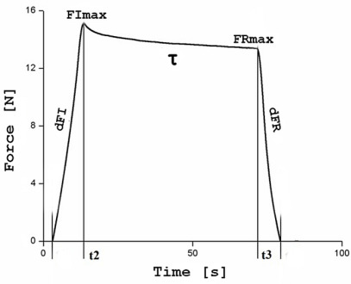
IMPACT FORCE
LITERATURE REVIEW
In vitro macro-indentation forces on phantoms
Reference Force range: 0.38 – 14.6
Nowak, J., & Kaczmarek, M. K. (2024). Deep Indentation Tests of Soft Materials Using Mobile and Stationary Devices. Materials (Basel, Switzerland), 17(17), 4233. https://doi.org/10.3390/ma17174233
Notes:
I pick up the ref. force range from related work, the in vitro macro-indentation forces on phantoms, which is one candidate closely related to my work, the force range they use to press the phantom is around 0.38 – 14.6 N that will use force my force ref.
So how can we know the impact force without touching

Slide 14
JET IMPINGEMENT
Notes:
“To answer that, I analyzed the physics of jet impingement

Slide 15
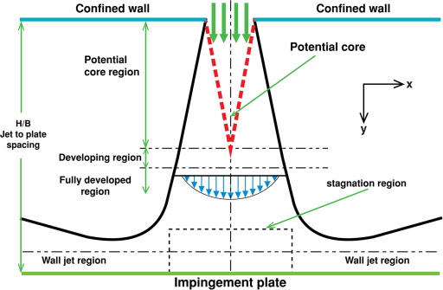
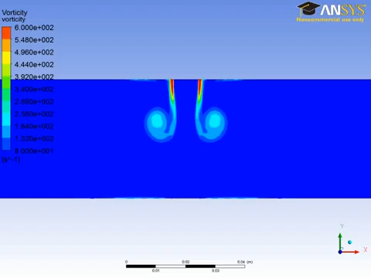
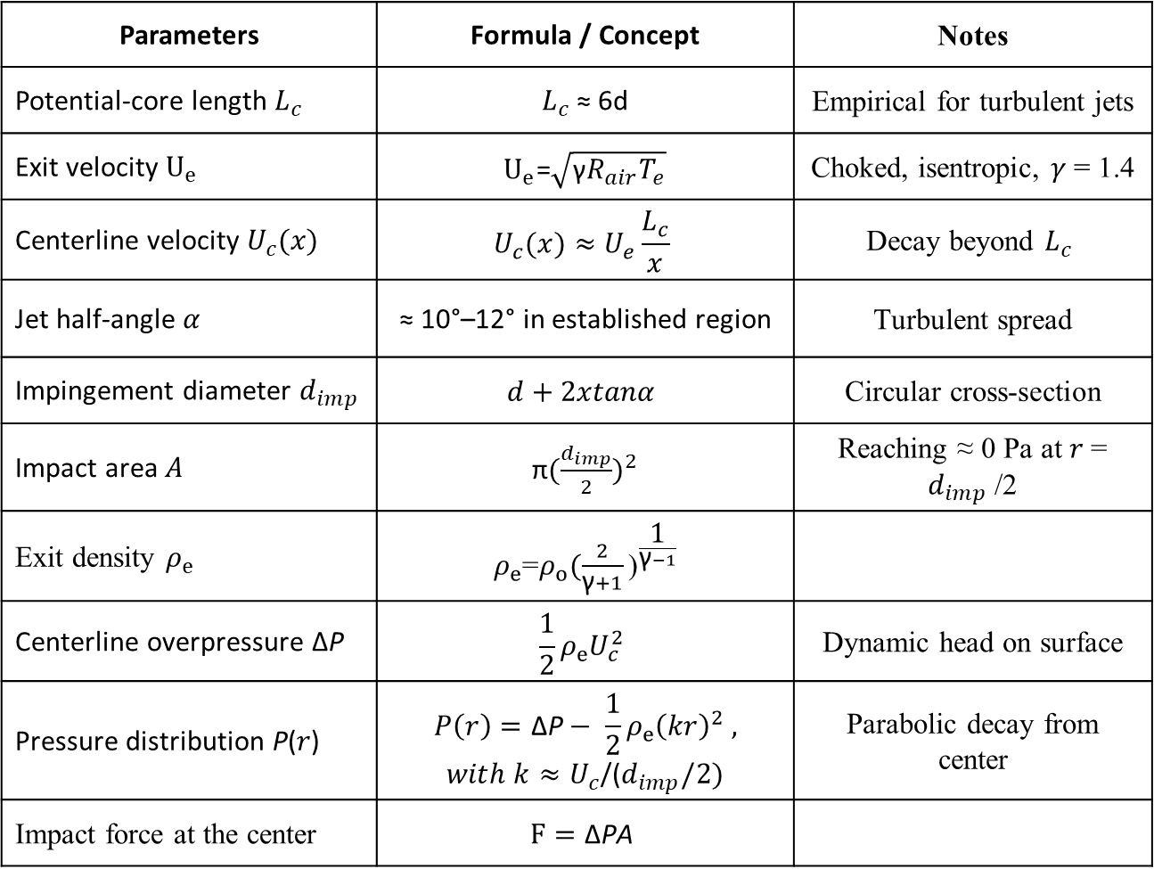
JET IMPINGEMENT
Parameters | Formula / Concept | Notes
Potential-core length $L_{c}$ | $L_{c}$≈ 6d | Empirical for turbulent jets
Exit velocity $U_{e}$ | $U_{e}$=$\sqrt{\text{γ}R_{air}T_{e}}$ | Choked, isentropic, 𝛾 = 1.4
Centerline velocity $U_{c}(x)$ | $$U_{c}(x)≈U_{e}\frac{L_{c}}{x}$$ | Decay beyond $L_{c}$
Jet half-angle 𝛼 | ≈ 10°–12° in established region | Turbulent spread
Impingement diameter $d_{imp}$​ | $$d+2xtanα$$ | Circular cross-section
Impact area 𝐴 | π$({\frac{d_{imp}}{2})}^{2}$ | Reaching ≈ 0 Pa at 𝑟 = $d_{imp}$/2
Exit density $ρ_{e}$ | $ρ_{e}$=$ρ_{o}{(\frac{2}{\text{γ}+1}\text{)}}^{\frac{\text{1}}{\text{γ}−1}}$
Centerline overpressure ΔP | $$\frac{1}{2}ρ_{e}U_{c}^{2}$$ | Dynamic head on surface
Pressure distribution P(𝑟) | $$P\left(r\right)=\text{Δ}\text{P}− \frac{1}{2}ρ_{e}{\left(kr\right)}^{2} ,$$ $with k≈U_{c}$/($d_{imp}/2)$ | Parabolic decay from center
Impact force at the center | $$F=\text{Δ}\text{PA}$$
Notes:
—how the airflow from the nozzle spreads, decays, and applies force to the tissue surface.”
“This part of the analysis models the jet behavior using core fluid mechanics principles. We start by estimating the potential core length and exit velocity under choked flow. From there, we compute the decay in centerline velocity and the jet’s half-angle expansion. This helps us estimate the impingement diameter—the width of the contact area—and ultimately, the impact pressure distribution across the surface.”
“The key outcome is the ability to calculate dynamic overpressure at the center and model how that pressure decreases radially. This parabolic pressure profile tells us both the maximum force applied and how it spreads across the region of interest. These insights are critical for ensuring that the system delivers a controlled, uniform force to the phantom during testing.”

Slide 16
LITERATURE REVIEW
LiDAR Camera
Light detection and ranging
Notes:
Next the main equipment in our work

Slide 17
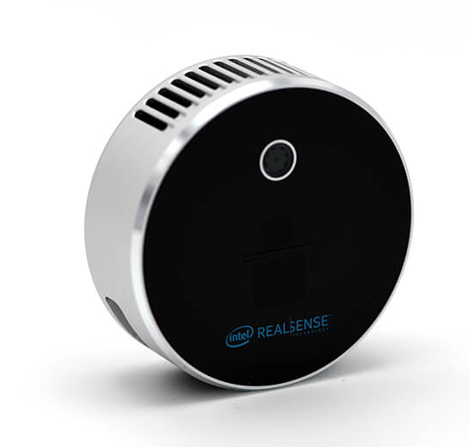
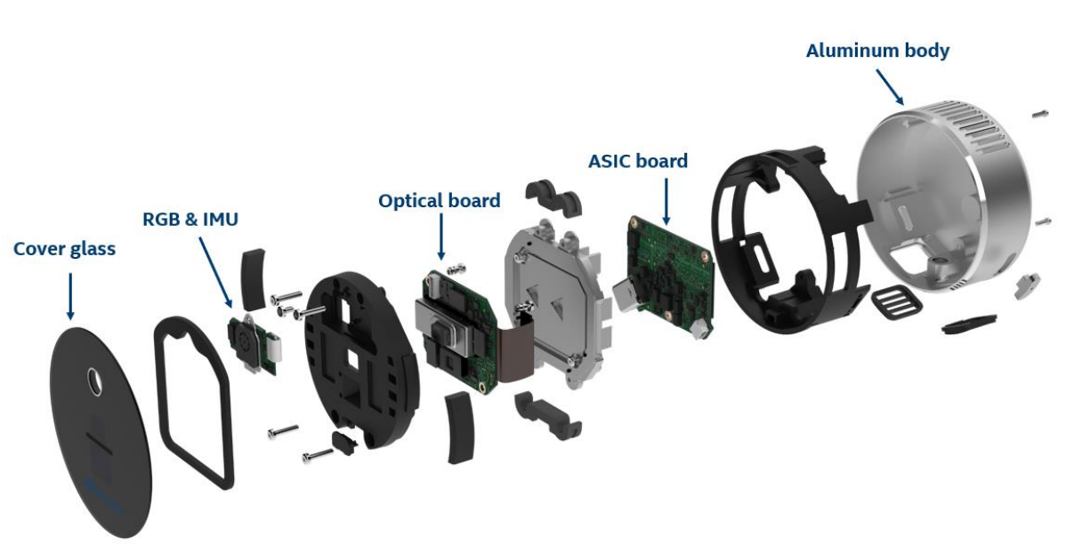
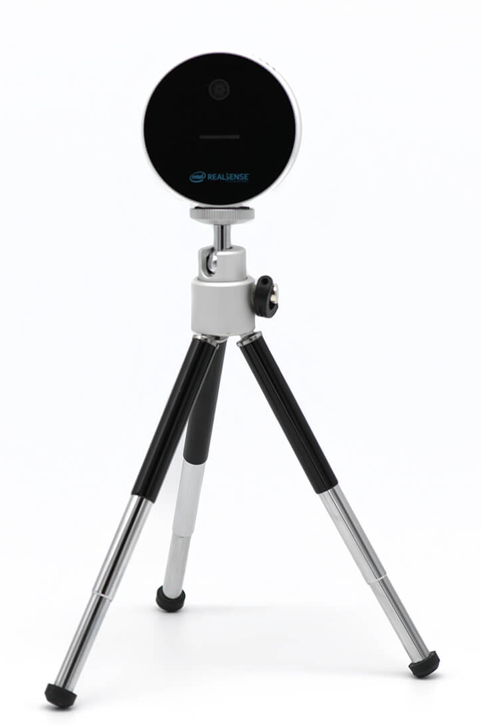
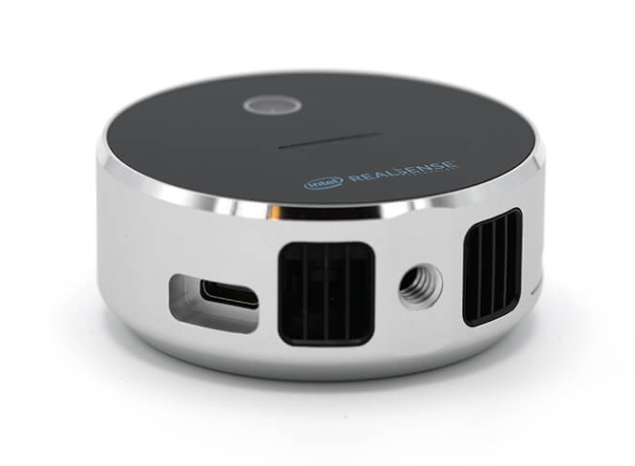
LITERATURE REVIEW
LiDAR Camera
Intel® RealSense™ LiDAR Camera L515
Camera Assembly

Slide 18
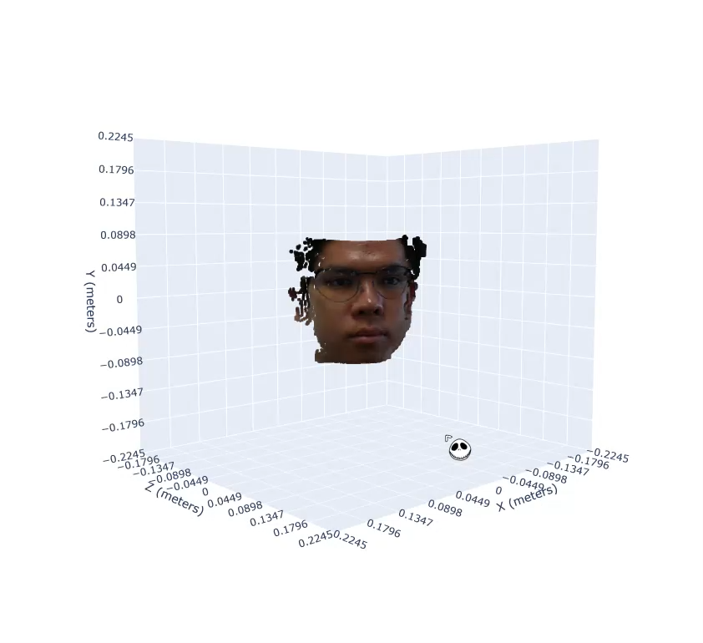
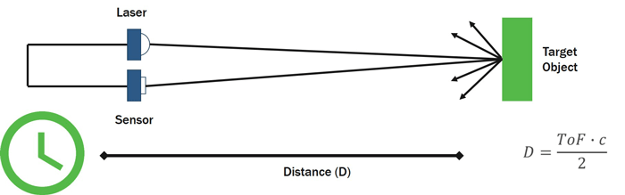
LITERATURE REVIEW
LiDAR Camera
Intel® RealSense™ LiDAR Camera L515
Camera Definition
Feature | Specification
Technology | LiDAR (Time-of-Flight)
Depth Resolution | Up to 1024 × 768
Frame Rate | Up to 30 fps
Depth Accuracy | < 5 mm at 1 m distance
Depth Distance | ~0.49 m – 3.5 m
Wavelength | 860 nm (infrared laser)
RGB Sensor | 1920 × 1080 @ 30 fps
Field of View (FOV) | H: 70° × V: 55° (depth)
LiDAR operates by emitting laser pulses and measuring the time it takes for the light to return after hitting an object, allowing for the creation of detailed 3D maps.
LiDAR Working Principle
Notes:
“The Intel RealSense L515 is a compact LiDAR-based depth sensor that uses time-of-flight technology. It emits near-infrared laser pulses and measures how long they take to bounce back from the surface—creating a dense 3D map of the scene.”

Slide 19
OBJECTIVE
Notes:
So from all I’m saying let’s warp up again in the work objective

Slide 20
OBJECTIVE
🔸 Design and integrate an air-jet module capable of delivering controlled forces with tunable pressure and nozzle configurations.
🔸 Implement a high-resolution depth tracking system using Intel RealSense L515 to capture sub-millimeter surface deformation in real-time.
🔸 Validate the system on phantoms by evaluating force repeatability, surface displacement accuracy, and computed stiffness / Young’s modulus within safe biomechanical thresholds.
Notes:
“The objective of this project was threefold:
First, to design and implement an air-jet module capable of delivering controlled, repeatable forces using adjustable pressure and nozzle configurations.
Second, to integrate a high-resolution LiDAR system—specifically the Intel RealSense L515—to capture sub-millimeter surface deformation in real time.
And third, to validate the system using soft-tissue phantoms by evaluating force accuracy, deformation tracking, and mechanical property estimation such as stiffness and Young’s modulus. Ultimately, the goal is to create a non-invasive, reliable alternative to traditional skin mechanics measurement.”

Slide 21
METHODOLOGY
Notes:
"First of all, let's explore the problem statement that drives this work."

Slide 22
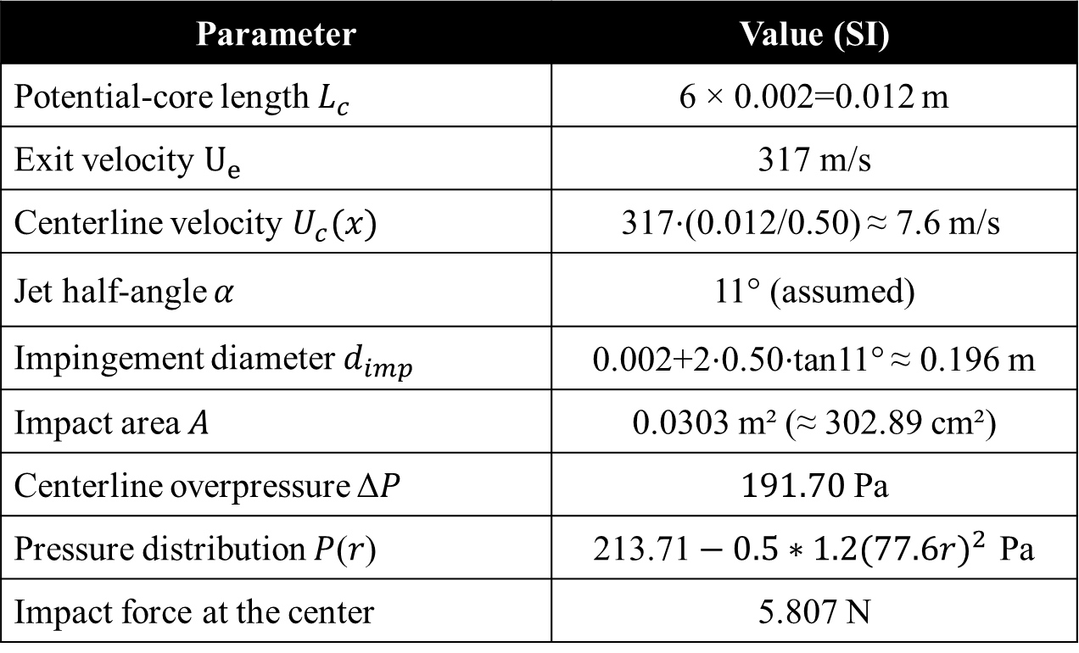
METHODOLOGY
Parameter | Value (SI)
Potential-core length $L_{c}$ | 6 × 0.002=0.012 m
Exit velocity $U_{e}$ | 317 m/s
Centerline velocity $U_{c}(x)$ | 317⋅(0.012/0.50) ≈ 7.6 m/s
Jet half-angle 𝛼 | 11° (assumed)
Impingement diameter $d_{imp}$​ | 0.002+2⋅0.50⋅tan11° ≈ 0.196 m
Impact area 𝐴 | 0.0303 m² (≈ 302.89 cm²)
Centerline overpressure Δ$P$ | $191.70$Pa
Pressure distribution $P$(𝑟) | $\text{213.71}−0.5∗1.2({77.6r)}^{2 }$Pa
Impact force at the center | 5.807 N
Condition
Pressure from the air blower 0.9 MPa
Distance between camera and phantom: 50 cm
Nozzle diameter 2 mm
Ideal gas with choked flow
Force range: 0.38 – 14.6 N

Slide 23
METHODOLOGY
ROI CALCULATION
(Region of Interest)

Slide 24

ROI CALCULATION
METHODOLOGY
Skin Phantom Condition
Mechanical Properties
Phantom material | E (Young’s modulus) kPa
Gelatin Phantom (30 – 180 g/L) | 4.8 – 158
Agarose Phantom (5 – 30 g/L) | 7.6 - 195
From Young’s modulus;
$$E=\frac{FL}{A∆L}$$
Calculate ROI selection (A) by;
$$A=\frac{FL}{E∆L}$$
Phantom thickness 30 mm
Force : 5.807 N
$∆$L from LiDAR

Slide 25
Next Steps and
Development Pathway
Notes:
"First of all, let's explore the problem statement that drives this work."

Slide 26
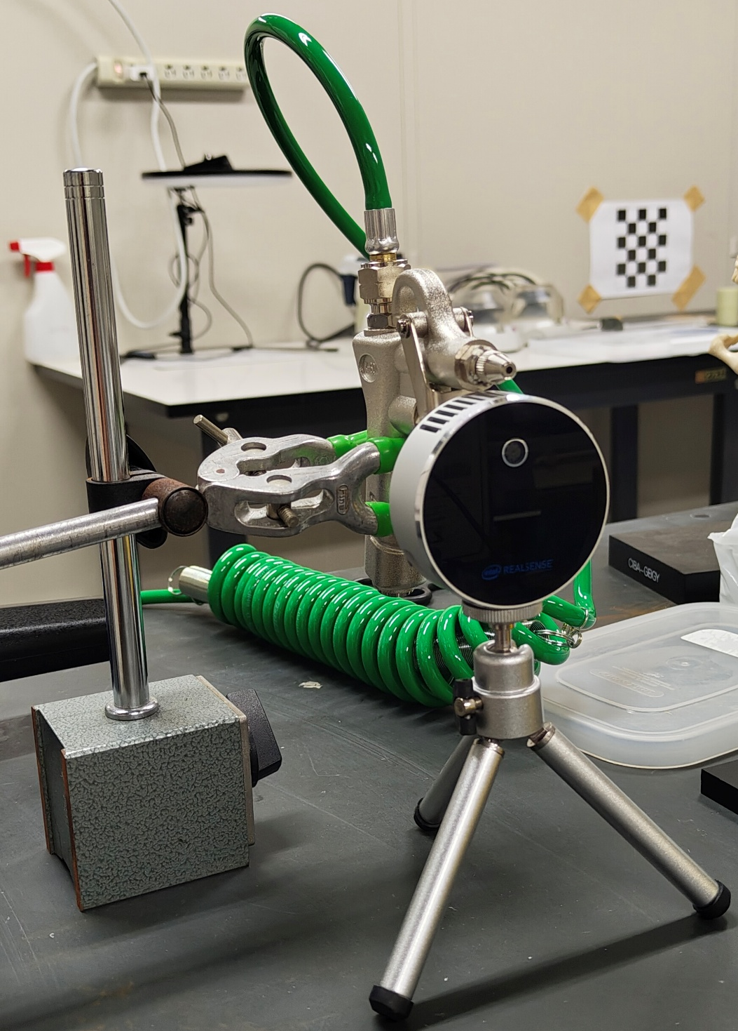
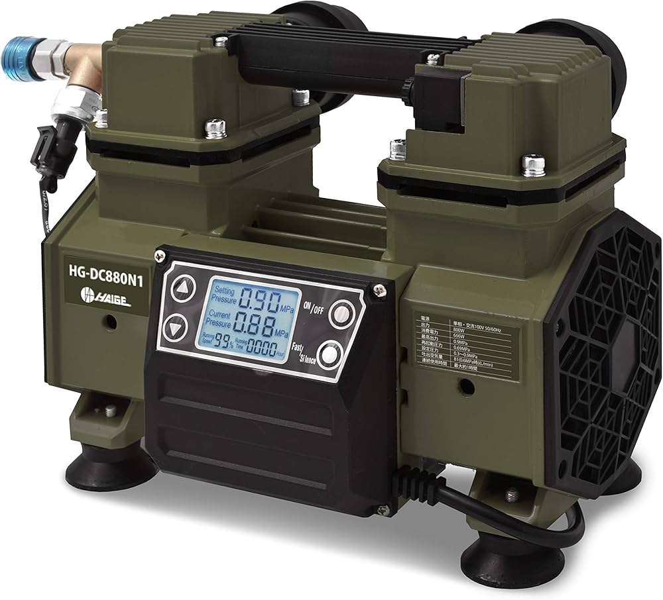
Next Steps and
Development Pathway
✅ Current Progress
📌 Identified suitable phantom materials and concentrations (e.g., gelatin, agarose)
🎯 Defined Region of Interest (ROI) for LiDAR measurement
💨 Determined air-blower specifications for force delivery (1–15 N)
🛠️ Completed draft of experimental setup combining air-jet and LiDAR
Distance 50 cm
Experiment Set Up

Slide 27
Next Steps and
Development Pathway
Phantom Fabrication
Produce phantoms with known mechanical properties and controlled thickness
Ensure reproducibility for stiffness calibration
Force Calibration and Jet Characterization
Quantify force vs. pressure relation at nozzle exit
Validate jet impact force distribution over ROI
System Integration and Testing
Combine air-jet and LiDAR in controlled lab conditions
Run pilot tests to verify repeatable deformation tracking
Data Analysis and Model Fitting
Calculate stiffness, Young’s modulus from deformation data
Compare with known phantom properties for validation
🔄 Next Steps

Slide 28

THANK YOU
Q & A
Notes:
Thank you for your attention

Slide 29
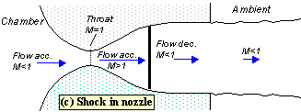
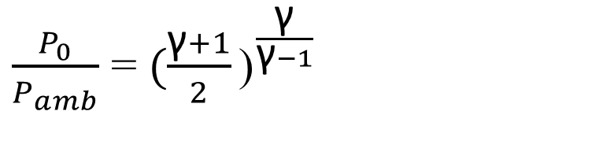

JET IMPINGEMENT
PARAMETERS CALCULATION
Flow Behavior
Establish whether the flow is choked at the nozzle throat
For ideal gases with γ = 1.4 (air), choked (sonic) flow occurs whenever the nozzle‐entry (stagnation) to exit (ambient) pressure ratio exceeds:
Here, $P_{0}$/ $P_{amb}$= 1 MPa/0.1 MPa = 10 ≫1.893, so the exit Mach number is ​ $M_{e}$ =1 (choked flow)
$\frac{P_{0}}{P_{amb}}$ = ${(\frac{\text{γ}+1}{2}\text{)}}^{\frac{\text{γ}}{\text{γ}−1}}$ ​
https://en.wikipedia.org/wiki/Choked_flow

Slide 30
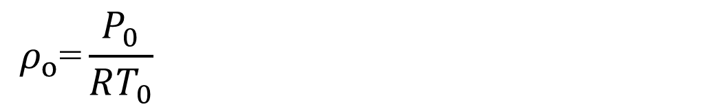


JET IMPINGEMENT
PARAMETERS CALCULATION
Air Density
Establish whether the flow is choked at the nozzle throat
From isentropic relations, the static pressure at the throat/exit is:
The total (stagnation) density is given by the ideal-gas law at $P_{0}$, $T_{0}$​:
$P_{e}$= $P_{0}{(\frac{2}{\text{γ}+1}\text{)}}^{\frac{\text{γ}}{\text{γ}−1}}$
$${ ρ}_{o}\text{=}\frac{P_{0}}{RT_{0}}$$
https://en.wikipedia.org/wiki/Choked_flow

Slide 31
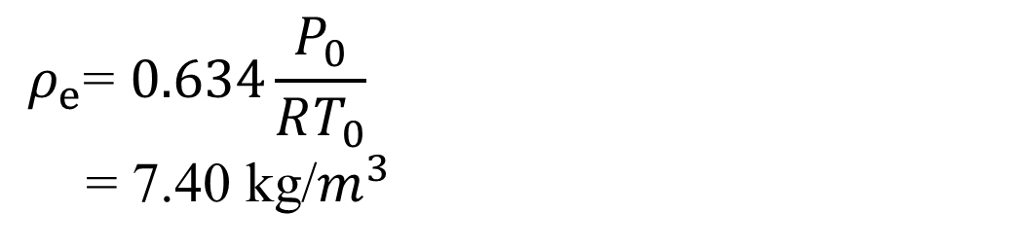
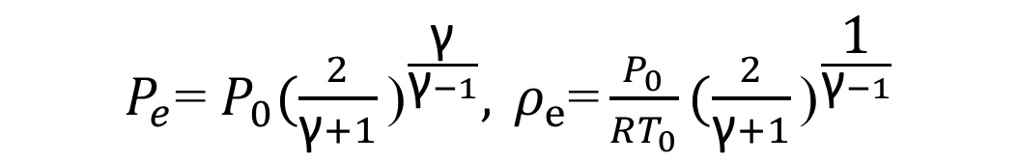

JET IMPINGEMENT
PARAMETERS CALCULATION
Air Density
Establish whether the flow is choked at the nozzle throat
Combining the two gives
For air (𝛾=1.4); ${(\frac{2}{\text{γ}+1}\text{)}}^{\frac{\text{1}}{\text{γ}−1}}$ = 0.634
So,
$P_{e}$= $P_{0}{(\frac{2}{\text{γ}+1}\text{)}}^{\frac{\text{γ}}{\text{γ}−1}},{ ρ}_{e}\text{=}\frac{P_{0}}{RT_{0}}{(\frac{2}{\text{γ}+1}\text{)}}^{\frac{\text{1}}{\text{γ}−1}}$
$${ ρ}_{e}\text{=} 0.634\frac{P_{0}}{RT_{0}}$$
= 7.40 kg/$m^{3}$
https://en.wikipedia.org/wiki/Choked_flow

Slide 32
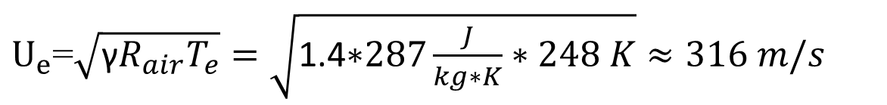

JET IMPINGEMENT
PARAMETERS CALCULATION
Velocity
Compute the nozzle‐exit velocity $U_{e}$
Under choked, isentropic conditions, the exit static temperature is
and the sonic speed at the exit is
Thus, the jet issues at about 316 m/s
$T_{e}$= $T_{0} \frac{2}{\text{γ}+1}=298K\frac{2}{2.4}≈248K$ ​
$U_{e}$=$\sqrt{\text{γ}R_{air}T_{e}}=\sqrt{\text{1.4∗}287\frac{J}{kg∗K}∗248 K}≈316 m/s$​
https://en.wikipedia.org/wiki/Choked_flow

Slide 33
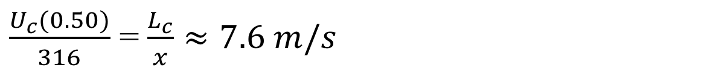
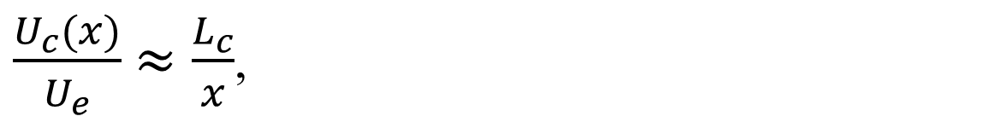

JET IMPINGEMENT
PARAMETERS CALCULATION
Velocity
Centerline velocity decay of an axisymmetric free jet
For 𝑥 beyond the potential‐core length $L_{c}$​ , the centerline velocity decays approximately as
where $L_{c}$​ is the axial distance at which $U_{c}$/ $U_{e}$first falls to unity (end of potential core)
Empirically, for many nozzles $L_{c}$≈ 6 𝑑 (Turbulent Flow).
If the nozzle diameter is 𝑑=2 mm, then $L_{c}$≈ 0.012 m.
At x = 0.50 m,
$\frac{U_{c}(x)}{U_{e}}$ $≈\frac{L_{c}}{x}$,​
$\frac{U_{c}(0.50)}{316}$ = $\frac{L_{c}}{x}≈7.6 m/s$​
https://ntrs.nasa.gov/api/citations/19720016717/downloads/19720016717.pdf

Slide 34
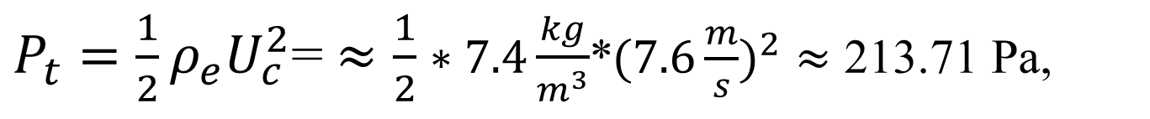
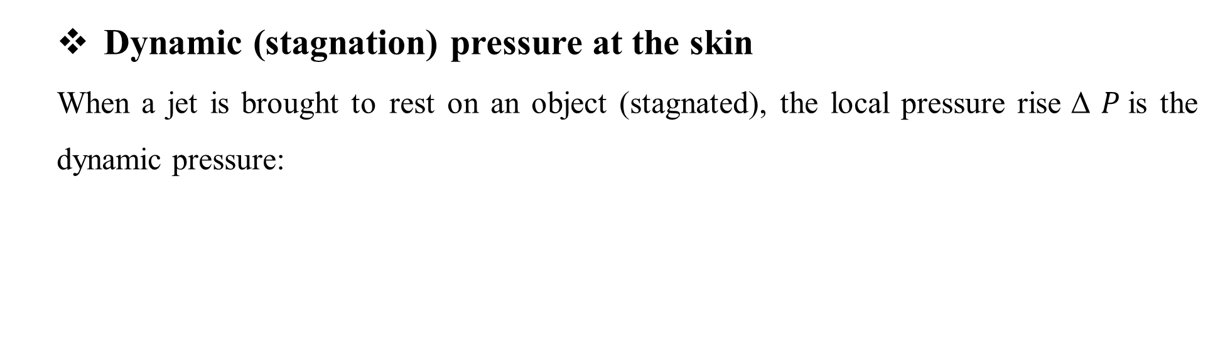
JET IMPINGEMENT
PARAMETERS CALCULATION
Stagnation Pressure
Dynamic (stagnation) pressure at the skin
When a jet is brought to rest on an object (stagnated), the local pressure rise Δ $P$is the dynamic pressure:
$P_{t}=\frac{1}{2}ρ_{e}U_{c}^{2}$= $≈\frac{1}{2}∗7.4\frac{kg}{m^{3}}$*${(7.6\frac{m}{s})}^{2}$ $≈$ 213.71 Pa,​
https://en.wikipedia.org/wiki/Stagnation_pressure

Slide 35
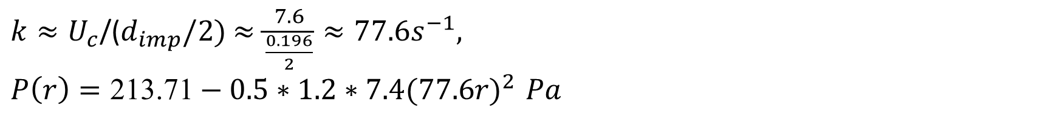
JET IMPINGEMENT
PARAMETERS CALCULATION
Pressure Distribution P(𝑟)
Stagnation pressure at 𝑟 = 0:
Radial decay:
Key takeaway:
Although the blower supplies 1 MPa, at 0.5 m the skin “sees” only ≈ 213.71 Pa at the center,
over an area of ≈ 300 cm², with a smooth parabolic pressure decay towards the edges.
$P_{t}≈$ 213.71 Pa,​
$$P\left(r\right)=\text{Δ}\text{P}− \frac{1}{2}ρ_{e}{\left(kr\right)}^{2}$$
$k≈U_{c}\text{/(}d_{imp}/2)$ $≈\frac{7.6}{\frac{0.196}{2}}≈77.6s^{−1},$
$P\left(r\right)=\text{213.71}−0.5∗1.2∗7.4({77.6r)}^{2 }Pa$ ​

Slide 36
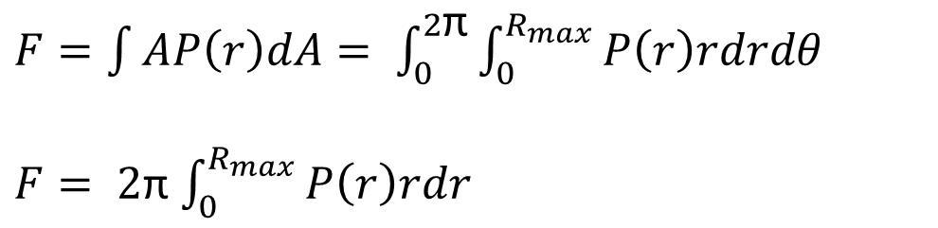

JET IMPINGEMENT
PARAMETERS CALCULATION
Impact Force
Integral expression for force
For an axisymmetric pressure distribution $P$(𝑟) (gauge over ambient) on a flat circular spot, the total force is
where $R_{max} is the$radius at which $P$(𝑟) first returns to zero.
$F=\int{A​P\left(r\right)dA= \int_{0}^{2\text{π}}{\int_{0}^{R_{max}}{P\left(r\right)rdrdθ }}}$
$F= 2\text{π}$ $\int_{0}^{R_{max}}{P\left(r\right)rdr }$

Slide 37


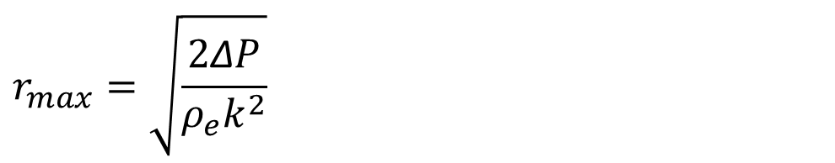
JET IMPINGEMENT
PARAMETERS CALCULATION
Impact Force
Parabolic (stagnation‑point) model
We previously showed near the centerline
with
Thus, the overpressure falls roughly as ${(r)}^{2}$, reaching ≈ 0 Pa at 𝑟 = $d_{imp}$/2
$P\left(r\right)=\text{Δ}P− \frac{1}{2}ρ_{e}{\left(kr\right)}^{2},\text{ 0} \text{≤} r \text{≤} r_{max}$​ ,
$$r_{max}=\sqrt{\frac{2\text{Δ}P}{ρ_{e}k^{2}}}$$

Slide 38


JET IMPINGEMENT
PARAMETERS CALCULATION
Impact Force
Closed‑form integral
Plugging into the integral
Thus, the total force depends only on the peak overpressure $\text{Δ}P$​ , the strain‑rate 𝑘, and the zero‑pressure radius $r_{max}$
$\text{π}r_{max}^{2}$ = Maximum impact area
$F= 2\text{π}$ $\int_{0}^{r_{max}}{[\text{Δ}P− \frac{1}{2}ρ_{e}{\left(kr\right)}^{2}]rdr }$
$= 2\text{π}$ [$\text{Δ}P\int_{0}^{r_{max}}{rdr− \frac{1}{2}ρ_{e}k^{2}\int_{0}^{r_{max}}{r^{3} }dr] }$
$= 2\text{π}$ [$\text{Δ}P\frac{r_{max}^{2}}{2} − \frac{1}{2}$ $ρ_{e}k^{2}$ $\frac{r_{max}^{4}}{4}$]
$= \text{π}\frac{{\text{Δ}P}^{2}}{ρ_{e}k^{2}}$ = $\frac{\text{π}r_{max}^{2}\text{Δ}P}{2}$ ;$[\text{Δ}P=\frac{1}{2}ρ_{e}{\left(kr\right)}^{2}]$

Slide 39
ROI CALCULATION
METHODOLOGY
Mechanical Properties
Phantom material | E (Young’s modulus) kPa | Force (N) | ROI of 5 mm Def. (cm²) | ROI of 10 mm Def. (cm²)
Gelatin Phantom (30 g/L) | 4.16 | 6.452 | 93.053 | 46.526
Gelatin Phantom (180 g/L) | 175 | 6.452 | 2.212 | 1.106
Agarose Phantom (5 g/L) | 7.08 | 6.452 | 54.675 | 27.338
Agarose Phantom (30 g/L) | 201.86 | 6.452 | 1.918 | 0.959
Impact Area ≈ 303 cm²
The maximum deformation starts at the center and decreases toward the edge
10 mm Def. start
5 - 10 mm Def.
5 mm Def. start
The ROI was chosen within the RED zone with optimal for LiDAR accuracy
Phantom thickness 30 mm
Deformation Range > 5 mm according to LiDAR accuracy

Slide 40
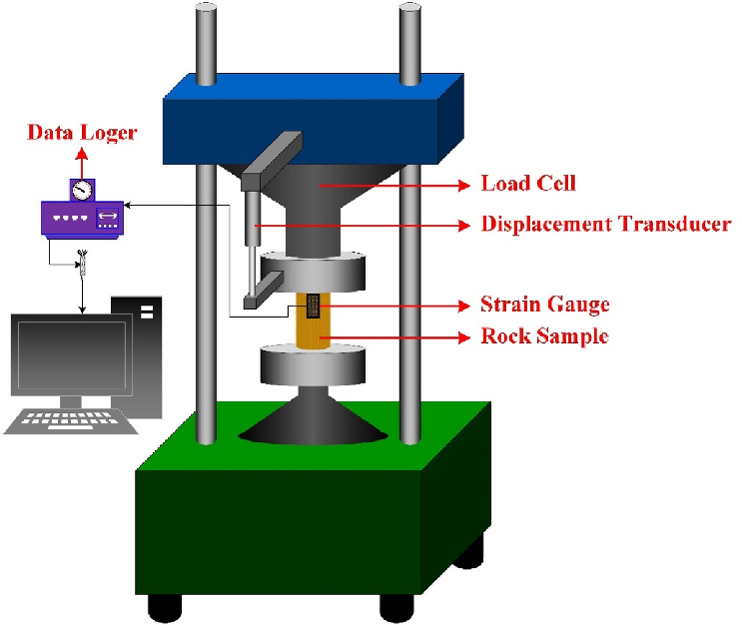
Non-invasive Skin Properties Estimation Using Air-jet Indentation And Active Lidar Sensing
Overview of Measuring Skin Mechanical Properties
Uniaxial Compression Test
Mocking skin phantom.
Measure skin elasticity by applying uniaxial compression

Slide 41

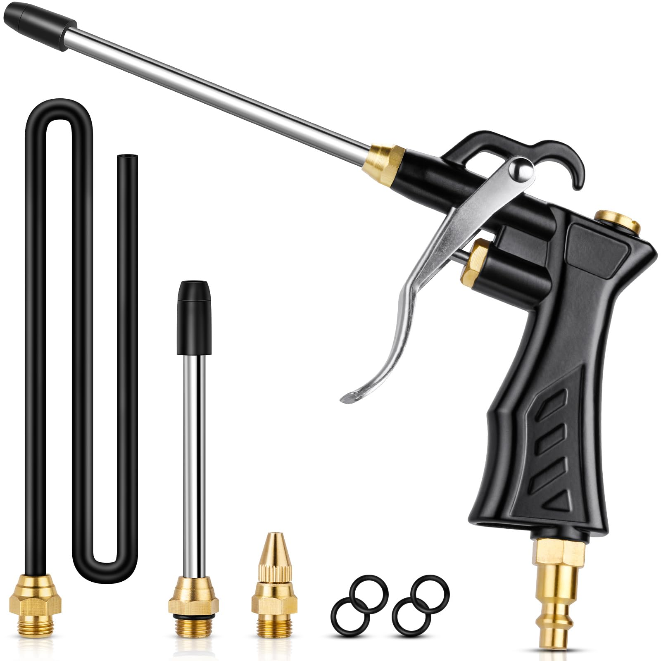
Calculate Skin Mechanical Properties By Using LiDAR
Minimum Distance 49 cm
Experiment Set Up

Slide 42
LITERATURE REVIEW
Overview of Skin
Phantom Properties
Skin Phantom
Feature | Gelatin Phantom (10 % w/w) | Agarose Phantom (2 % w/w)
Young’s modulus E | 22 – 40 kPa (10 % gelatin; temperature‐dependent) | ≈100 kPa (2 % agarose, small‐strain)
Tunable range | 10 – 50 kPa by adjusting concentration (5 – 16 % w/w) | 20 – 450 kPa by 1 – 6.6 % w/w range
Surface finish | Naturally matte (good LiDAR reflectance) | Slightly glossy (blot or matte‐spray recommended)
Durability & storage | • Use within 1 week; sealed at 4 °C to avoid drying & mold | • Use within 5 days; sealed & hydrated at 4 °C to prevent syneresis
Pros | – Very low cost; food‐grade ingredients – Easily tunable concentration – No special equipment beyond a refrigerator | – Heat‐stable gel; minimal microbial risk – Wide stiffness tunability – Good long‐term dimensional stability
Cons | – Short lifespan (<1 week); prone to dehydration & spoilage – Mechanical properties drift with temperature | – Requires hot handling and rapid pouring – Brittleness at low concentrations – Limited working window before gelation
(3)

Slide 43
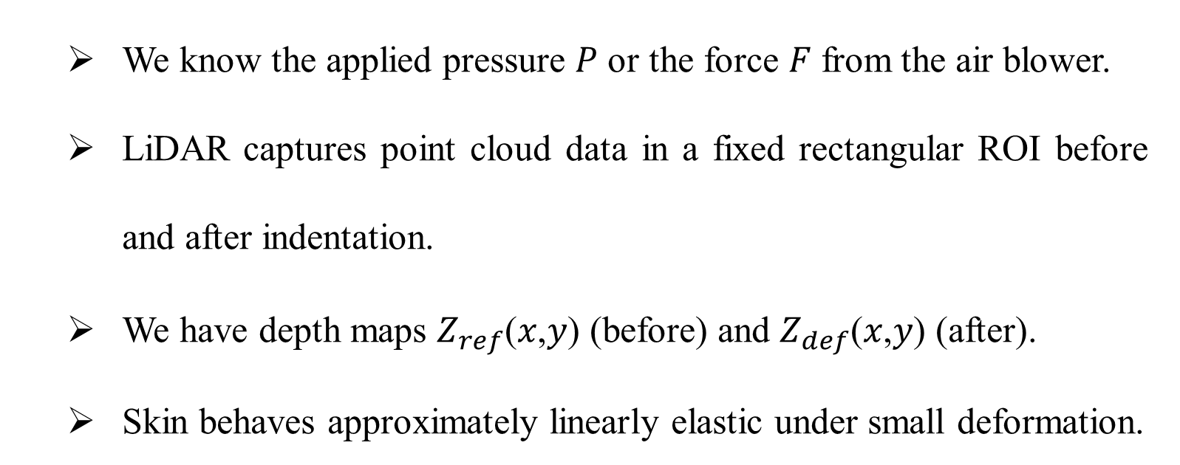
Non-invasive Skin Properties Estimation Using Air-jet Indentation And Active Lidar Sensing
Calculate Skin Mechanical Properties By Using LiDAR
Assumptions
We know the applied pressure 𝑃 or the force 𝐹 from the air blower.
LiDAR captures point cloud data in a fixed rectangular ROI before and after indentation.
We have depth maps $Z_{ref}$(𝑥,𝑦) (before) and $Z_{def}$(𝑥,𝑦) (after).
Skin behaves approximately linearly elastic under small deformation.

Slide 44
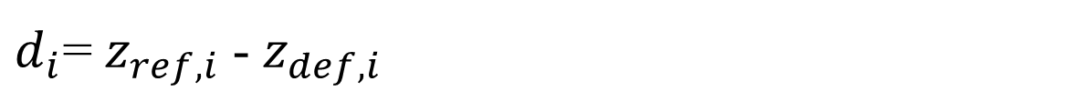


Non-invasive Skin Properties Estimation Using Air-jet Indentation And Active Lidar Sensing
Calculate Skin Mechanical Properties By Using LiDAR
Step-by-Step Method:
Step 1: Select Fixed ROI
Define a fixed window on the LiDAR point cloud (e.g., 5 cm × 5 cm) centered at the indentation site.
The ROI contains many points: each has ($x_{i}$, $y_{i}$, $z_{i}$).
Step 2: Compute Deformation Map
For each point 𝑖 in the ROI:
Where:
$z_{ref,i}$ : initial depth (pre-indentation)
$z_{def,i}$​ : deformed depth (post-indentation)
$d_{i}$: local indentation depth at point 𝑖
$d_{i}$= $z_{ref,i}$- $z_{def,i}$​

Slide 45



Calculate Skin Mechanical Properties By Using LiDAR
Step-by-Step Method:
Step 3: Compute Global Indentation Parameters
Maximum Indentation Depth
This is often used to represent the strain input.
Average Indentation Depth
$$\overline{d}=\frac{1}{N}\sum_{1}^{N}{d_{i}}$$
Where 𝑁 is the number of points in the ROI.
Volume of Deformation
approximate the volume 𝑉 between the two surfaces:
$V=\frac{1}{N}\sum_{1}^{N}{d_{i}}$* $A_{p}$
Where:
$A_{p}$ is the area per point,
e.g., $A_{p}$ =Δ𝑥⋅Δ𝑦 (depends on resolution).
$d_{max}$= $\max_{i} (d_{i})$​

Slide 46


Calculate Skin Mechanical Properties By Using LiDAR
Step-by-Step Method:
Step 4: Estimate Applied Force
From air pressure:
Where:
$P$: applied pressure (Pa)
$A_{contact}$​ : contact area, estimate from ROI or indentation footprint
$F$= $P∗$ $A_{contact}$​

Slide 47


Calculate Skin Mechanical Properties By Using LiDAR
Step-by-Step Method:
Step 5: Calculate Skin Properties
Option A: Stress-Strain Formula, if we know skin thickness h:
Where:
$h: estimated skin thickness \left(e.g., 1.5 mm\right)$
$\overline{d} :$average deformation from LiDAR
$A_{contact}$​ : area where pressure was applied
$E$= $\frac{Stress}{Strain}=\frac{F/A_{contact}}{\overline{d}/h}=\frac{F∗h}{A_{contact}∗\overline{d}}$​

Slide 48

Calculate Skin Mechanical Properties By Using LiDAR
Step-by-Step Method:
Step 5: Calculate Skin Properties
Option B: Stiffness Model (if h is unknown), use effective stiffness:
$k$= $\frac{F}{\overline{d}}(\frac{N}{m})$​

Slide 49

Calculate Skin Mechanical Properties By Using LiDAR
Final Output:
$\overline{d}$: mean deformation (from LiDAR)
$d_{max}$​ : peak indentation depth
𝑉: volume of indentation
𝐸: estimated Young’s modulus
𝑘: effective stiffness

Slide 50
ROI CALCULATION
LiDAR L515 accuracy
Less than 5 mm at a distance of 1 meter and less than 14 mm at 9 meters, under optimal conditions with 95% reflectivity.
The appropriate deformation that LiDAR is likely to detect is 5 – 10 mm at a distance of 1 meter.

Slide 51



LiDAR CALIBRATION
Calibration Step
Set the object away from LiDAR 50 cm
Measuring in 2 cm x 2 cm ROI
Measuring 60 times at the same distance (60s)
Calculate accuracy(Bias) and precision(Uncertainty)
Increase distance by 10 cm at a time to 60 cm
Plot graph

Slide 52

LiDAR CALIBRATION
Results
Reference Distance (mm) | Bias (mm) | Uncertainty (Std Dev) (mm) | Mean Measured Distance (mm)
500 | 0.11 | 0.7 | 500.11
510 | -0.65 | 0.78 | 509.35
520 | -0.14 | 0.82 | 519.86
530 | -0.23 | 1 | 529.77
540 | 0.38 | 0.95 | 540.38
550 | 0.02 | 0.97 | 550.02
560 | -0.08 | 0.89 | 559.92
570 | 1.69 | 1.15 | 571.69
580 | -2.03 | 1.33 | 577.97
590 | -0.25 | 1.16 | 589.75
600 | 0.59 | 0.99 | 600.59
500.11 ± 1.36 mm; [498.75 mm, 501.47 mm].
550.02 ± 1.90 mm; [548.12 mm, 551.92 mm].

